Slide 1

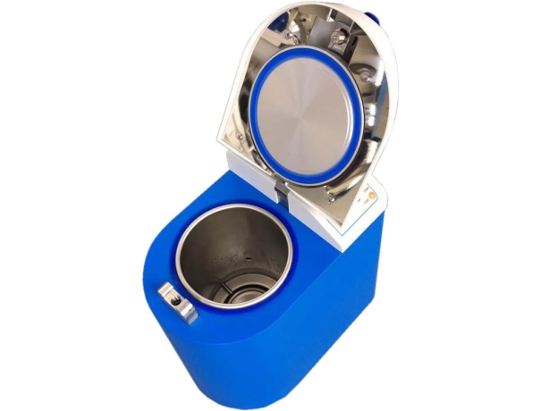
(Pulsating Electrothermal Drying)
Vertical Pressure Steam Sterilizer
（Please read the manual carefully before operating this machine）
Flip-open Door Type Vertical Autoclave Sterilizer
Model AVAYY D80-C
ALSIN Technology ServicesNo. 84/B, First Floor, Veerabhadreshwara Industrial Area,
(Near Max E Techno School) Herohalli, Viswaneedam Post, Bengaluru, Karnataka 560091
Phone: +91-90712 62001
+91-90712 62002
Email: support@alsin.in

Slide 2
Content
Content ............................................................................................................................................. 1
PREFACE........................................................................................................................................ 2
Equipment identification： .............................................................................................................. 3
Notes：............................................................................................................................................. 4
I．Unpacking, installation, debugging ......................................................................................... 6
  Unpacking........................................................................................................................... 6
  Checking the accessories. ................................................................................................... 6
  Required operations environment ....................................................................................... 7
  Installation .......................................................................................................................... 7
  Debugging .......................................................................................................................... 8
II. User Instructions........................................................................................................................ 9
  Product structure ................................................................................................................. 9
  Introduction of safety device ............................................................................................ 11
  Specifications.................................................................................................................... 11
III. Operating procedures of Autoclave Sterilizer ..................................................................... 13
  Preparation before Sterilization ........................................................................................ 13
    Preparation of instruments and containers. ............................................................ 13
    Preparation of rubber tube ..................................................................................... 13
    Preparation of dressing bag.................................................................................... 13
    Preparation of Medium .......................................................................................... 14
  Operation of Device.......................................................................................................... 14
    Introduction of user interface................................................................................. 14
    Operating procedures ........................................................................................... 15
    Fault indication ...................................................................................................... 21
IV. Corrective Maintenance ......................................................................................................... 21
  Maintenance...................................................................................................................... 21
  Failure analysis table ........................................................................................................ 22
  Changing the sterilizer water ............................................................................................ 22
  Checking the safety valve ................................................................................................. 22
  How to replace the safety valve ........................................................................................ 23
  Thermostat ........................................................................................................................ 23
  How to improve the operating temperature of the thermostat .......................................... 23
V. Service .................................................................................................................................... 23
1

Slide 3
PREFACE
Dear Users:
Welcome to choose Flip-open Door Type Vertical Autoclave Sterilizer (Model AVAYY D80-C) from Alsin, we hereby express our sincere thanks.
We sincerely hope that our product can bring you great help.
In order to let you know more about Flip-open door type vertical autoclave sterilizer, please read this manual carefully before using. This Manual is very helpful for you to operate safely and correctly.
After reading the manual, please put it in an appropriate position for easy access.
2

Slide 4



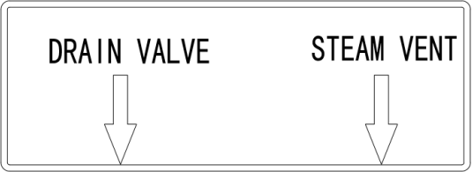

Equipment identification：
Paid great attention
Open door
ON OFF
Power
Grounding sign
:
Water draining
High temperature
Power supply: 220V 25A, Need a reliable grounding
Safety valve
Power ground
Safety valve
3

Slide 5
Notes:
Please using the machine according to the manual operation method and notes, if not, may damage the equipment protection system, and cause human unsafe factors and hazard.
The user manual should be preserved completely during usage period, and it should be transferred or handed over along with the device when the place changing.
Make ensure there is a gap of 25cm to the stuffs around the device for heat dissipation.
If equipment was stored under wet conditions, probably did not meet all requirements of
this user manual, therefore, it need aeration-drying for a period of time, and then keep it under normal conditions for storages.
This equipment is only suitable for the sterilization of high temperature and humidity-resistance medical instruments and stuffs, cannot be used for petroleum jelly, oil, powder, and high-volatility materials such as alcohol, gasoline and stuffs that corrode copper and aluminum.
If there is peculiar smell, abnormal noise during use, please cut off the power supply immediately, and contact with local distributor and our after-sales department.
The device is not suitable for sealed liquid material sterilization.
Unpackaged sterilization should be immediately reserved, transported and applicate under the clean condition, to avoid infection or cross infection again.
Only production enterprises, after-sales service department and authorized agent can check and provide the components. In addition, except the provided spare parts, the end-user and individual shall not replace any parts.
When the equipment failure, seriously damaged beyond repair, or exceed the lifetime, please deal with the equipment according to the local relevant laws and regulations.
4

Slide 6
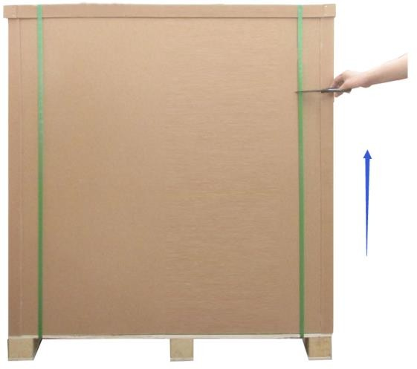
Unpacking, installation, debugging
Please firstly check if packing box is in good condition. If the packing box is damaged, please take photos.
1.1 Unpacking
Using the scissor to cut off the packing belts, take down the carton cover and move off the carton body, refer to picture 1.
Picture 1
Autoclave package
1.2 Checking the accessories.
Checking whether the accessories is complete according to the packing list
Packing list
Name | quantity | Position
Autoclave | 1pc | Carton
Drain pipe | 1 pc | Packing bag（above the cabinet）
Basket | 1pc | Inside the machine
User manual | 1pc | envelope （above the cabinet）
6

Slide 7
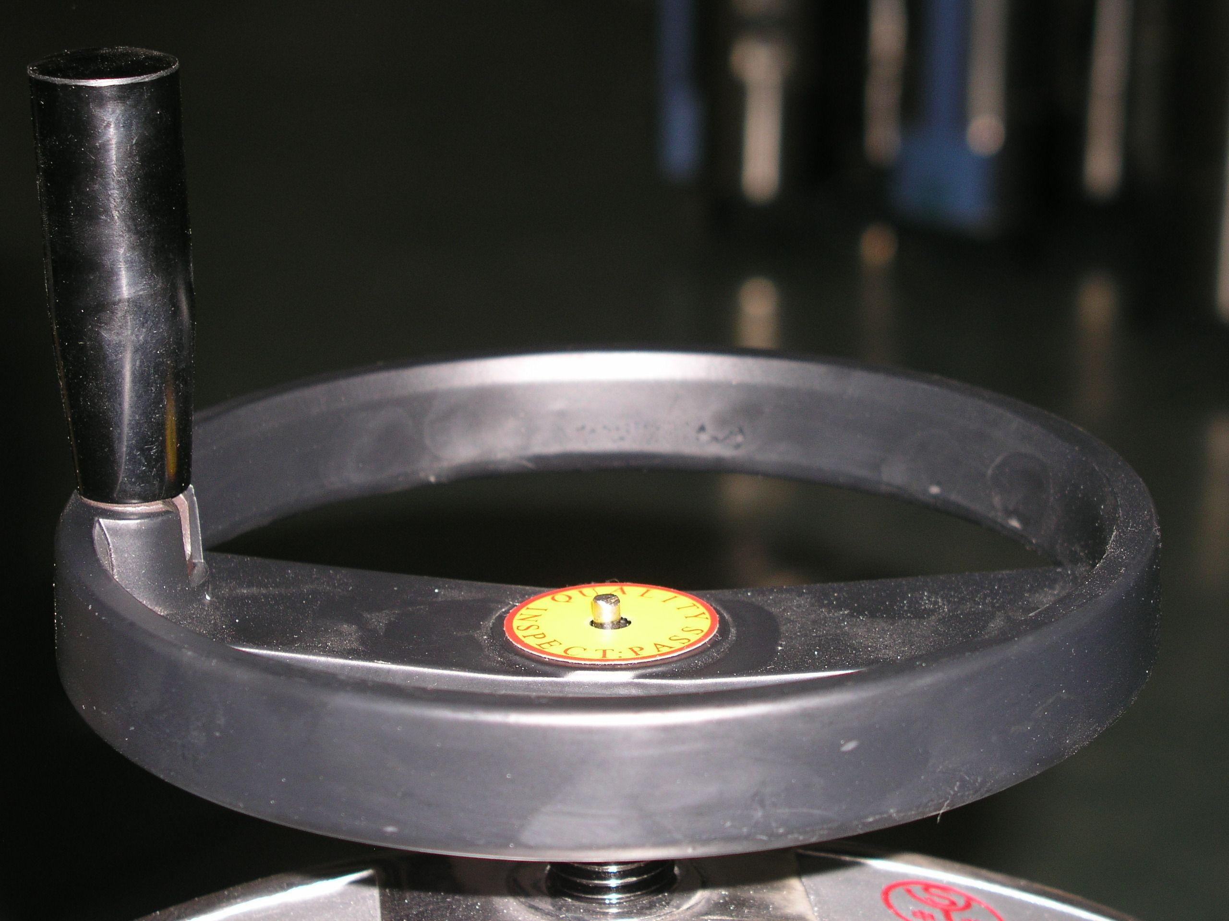

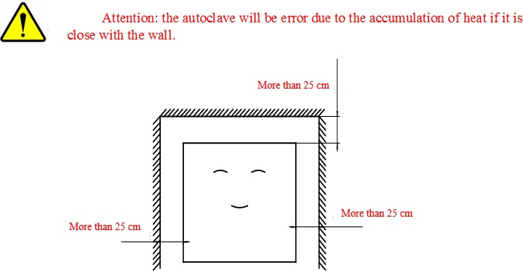
1.3 Required operations environment
The autoclave should be placed in a clean, dry, avoid light, ventilation, lower temperature difference indoor environment.
Indoor temp.: 5℃-40℃。
Max. relative humidity: 85%。
Allowed voltage fluctuating range: ±10%
No dust and pollution in the room.
1.4 Installation
1) Remove all packaging components; Place UTKBS-50V vertical type autoclave sterilizer on the smooth, clean and spacious ground, adjust feet of the machine to be parallel with the ground, to ensure it is stable and reliable. The distance between the back and sides of the machine with other objects must be at least 250 mm (as shown in picture 2), to ensure good ventilation.
Picture 2
Picture 3
Checking the surface of the body whether there is a scratch, deformation or foreign matters.
Checking the accessories and information according to the packing list, take out the spare parts from the packages, and check whether they are complete. Check whether the power supply shown in
the nameplate is same as the actual power supply, power on the equipment to test below items;
4) water preparation.
Test items | Normal condition
Open and close the door | The door is opened and closed smoothly
Display buttons | All the buttons is available
7

Slide 8
Water quality：
Electrical conductivity <15μA/cm
The content of bleach <2mg/L，hardness < 0.02mml/l PH: 5-7
Water volume: Adding water until the indicator light off.
1.5 Debugging
Open the door, put in the sterilizer indicator card and biological indicator card, reset and close the door tightly
Power on, the display will enter into program selection interface after 2 seconds.
8

Slide 9
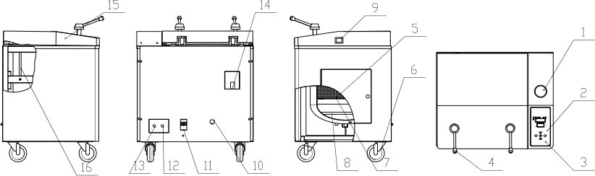
User Instructions
2.1 Product structure
Picture 3
Pressure gauge
Display screen
Control panel
Handle
Sterilization basket
Castor
Clapboard
Heating pipe
Power switch
Power line
Air switch
Exhaust port
Drain ball valve
Safety valve
Door cover
Gas spring
9

Slide 10
2) Main function of spare parts：
NO. | Description | Function
1 | pressure gauge | when the device is working, display the pressure within the main body
2 | display screen | the entire sterilization process under real-time macro monitoring
3 | control panel | mounting the display panel
4 | handle | rotating to open the door
5 | sterilization basket | loading sterilization items
6 | universal castor | support equipment and the equipment can be moved on a smooth surface
7 | clapboard | prevent sterilization items from splashed water below
8 | heating pipe | heating water for sterilization
9 | Power switch | control the equipment power
10 | power line | connect device with power supply (yellow is ground wire)
11 | air switch | main power switch and leakage protection
12 | exhaust outlet | cold air and steam release outlet
13 | drain ball valve | drain the wastewater from the chamber after sterilization
14 | safety valve | relief valve by a predetermined operating pressure to ensure safety
15 | door cover | cover of the door, acts as insulation to protect the operator
16 | gas spring | for easy opening

Slide 11
2.2 Introduction of safety device
UTKBS-50V Vertical Sterilizer safety device is provided as follows:
Automatic over-temperature protection: Over the programmed temperature, the system will automatically cut off the heating power, and display alarm information.
Alarm: When the temperature of the sterilization chamber is higher than the thermostat set temperature, the thermostat operate, the system will cut off the heating power (and show alarm
information).
Automatic pressure relief safety valve: Over setting pressure, the safety valve opens to release the pressure.
Circuit safety devices: AC short circuit protection.
2.3 Specifications
Suitable for sterilization of temperature-proof, pressure-proof, humidity-proof medical equipment, medical dressing kits, glassware, rubber, liquid and other items, it can also be used to sterilize laboratory medium.
Seven of the sterilizer sterilization procedures are as follows:
Procedure type | Pulse exhaust times | Pulse start temperature℃ | Pulse end temperature℃ | Sterilization temp℃ | Sterilization time set (min) | Soaking time
1#bare equipment | 1 | sterilization temperature -2.5 | Pulse start temperature -5 | 134 | 4 | 0
2#instrument set | 2 | sterilization temperature -2.5 | Pulse start temperature -5 | 134 | 8 | 0
3#rubber | 2 | sterilization | Pulse start | 121 | 25 | 0

Slide 12

 |  | temperature -2.5 | temperature -5
4#dressing | 3 | sterilization temperature -2.5 | Pulse start temperature -5 | 134 | 12 | 0
5#liquid type | 0 | — | — | 121 | 20 | 0
6# solid kind of custom | 0-9 | sterilization temperature -2.5 | Pulse start temperature -5 | 105~136 (134) | (0-999) | 0
7# liquid type of custom | 0 | — |  | 105~136 ( 134 ) | (0-999) | 0
Blow off valve close set | the local atmospheric pressure -2℃ (default 98℃); set range (80-110℃) |  |  |  | Description: a. fixed procedure can be set except for fixed parameters; drainage process during limited time 4 minutes and 100 ℃ were first starting time for the drying. b. liquid procedure to drain when cool to 105-110 °C, when cooled to 80 °C, suggesting sterilization is complete, open the door
Drainage selection set | After the completion of sterilization, drainage (Off / On) can be set; drain temperature (default is cooled to 105 ℃ when drainage), setting range: solid of custom (105 ~ 134 ℃); liquid of custom (105-110 °C)
Note： | Steam exhaust and drainage limit temperature not higher than the upper sterilization temperature.
The service life of the equipment design for five years
Notes
Sterilizer should strictly follow the steps described in the instruction manual operations. If sterilization is not functioning properly, you may want to consult this manual fault analysis table to see whether you can do the self-exclusion, if not you should immediately provide feedback to our service department. If you can provide a detailed description of sterilization failure and the potential required replacement model and the number of replaced parts, the company would be deeply grateful for your support.

Slide 13
Operating procedures of Autoclave Sterilizer
  Preparation before Sterilization
    Preparation of instruments and containers.
Please clean the instruments or containers first, in case the residuals on the instruments would harm the Autoclave Sterilize. For example blood and other impurities. We have developed specific cleaning solution for your reference:
We recommend that you use washing machines, cleaning agents and distilled water to clean instruments before sterilization.
Then wash it again to make sure it is clean.
When you put the instruments into basket, please put different type instruments into different
baskets. E.g. Stainless steel, carbon steel. And please leave adequate space between instruments. If put carbon steel equipment into basket, please put several layers of paper or paper kapok inside basket to avoid direct contact between carbon steel and stainless steel.
Test tubes and bottles should be placed with opening vertically downward to facilitate the replacement of cold air and the entrance of saturated steam.
Place a sterilization indicator card in each basket
Once a month, put spore creatures detection indicator in the load to detect the sterilization effect
The basket is not allowed to be overload (max. is 12kg), otherwise sterilization will be inadequate.
The instruments need to be sterilized should be wrapped with packaging material of good permeability. E.g. Sterilization bags, sterilization paper, muslin etc.
    Preparation of rubber tube
Please wash the rubber tube with warm water, and then place it on a clean sterile tray while ensuring that the tube is a hollow pipe with two openings, no sharp turn, twist, kink etc.
    Preparation of dressing bag
Put the dressing bags on the tray vertically to avoid connection with the inner wall of autoclave sterilizer.

Slide 14
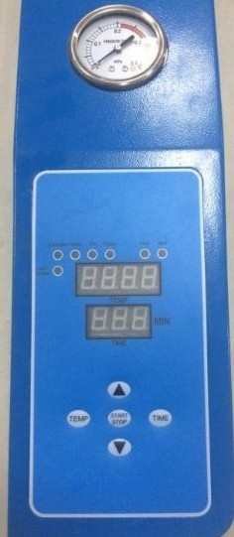
3.1.4 Preparation of Medium
Only medium basket is allowed to use, the load cannot exceed 2/3 of the volume to avoid the overflow of medium.
  Operation of Device
    Introduction of user interface
Five keys include “Temperature”, “Time”,“▲”、“▼” “On/off”. Six status indicator lamps: "water", "warm", "sterilization", "exhaust", "complete", "alarm "and the" temperature display window "," time display window "
Indicator light
Pressure gage
Temperature indicator
Time indicator
Buttons
Picture 4

Slide 15
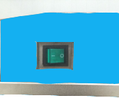

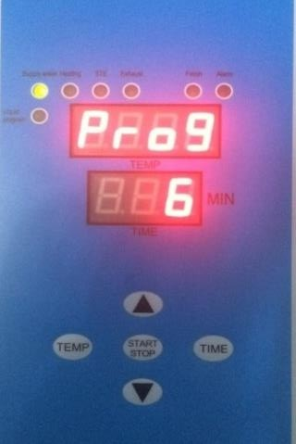
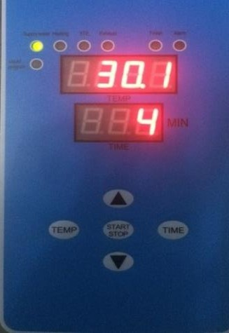
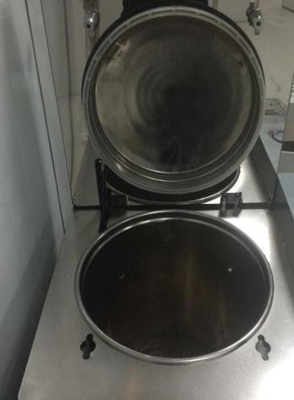
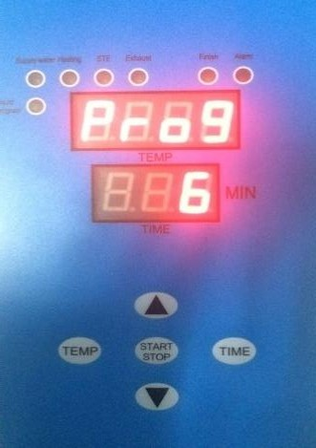
3.2.2Operating procedures
Power on
Power on, turned on the air switch behind and then turn on ship type switch on the control panel to enter the display panel.
Enter the display interface
The temperature display window display Prog, the time window display X(1-7)，indicating you have choosed X# sterilization program. Then the temperature and sterilization time set are displayed. This 2 images display alternately.
Injection
Open the lid to inject water to the pot until the water level
Light is off. Then put the item to be sterilized into basket and put basket into autoclave sterilizer. Closed door and choose sterilization procedure

Slide 16
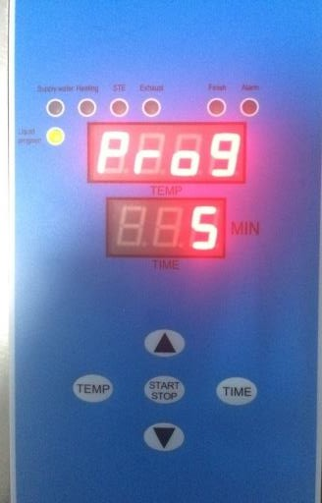
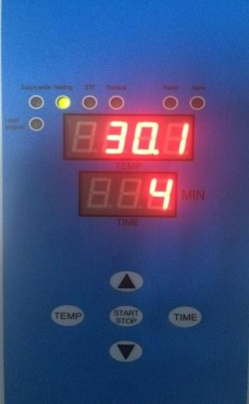
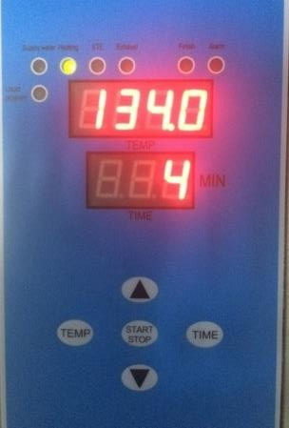
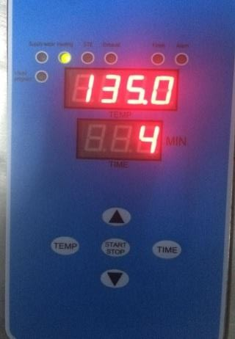
Select the sterilization program
You can select different sterilization procedures with
“▲”,“▼”.When you choose 5# liquid program,” Liquid” indicator Light is on. When you choose 7#liquid customized program, the indicator light flashes, indicating the program is for liquid.
Press the ‘Start/Stop’, the according sterilization program start
Sterilization temperature settings
Press the "temperature" button, temperature display window displays temperature values and flashes. Adjust temperature value by “▲”“▼”.
Repress "Temperature" button, the temperature set is stored.

Slide 17
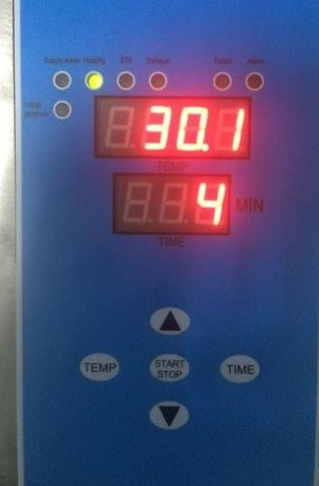
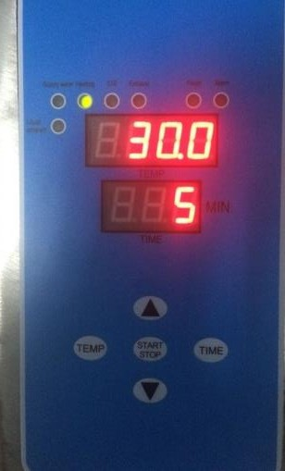
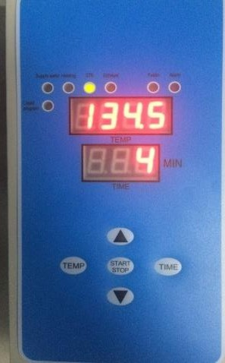
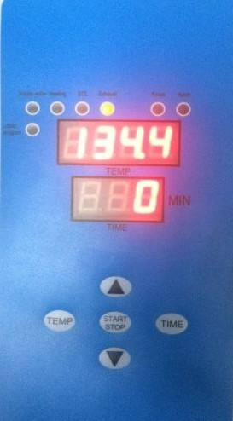
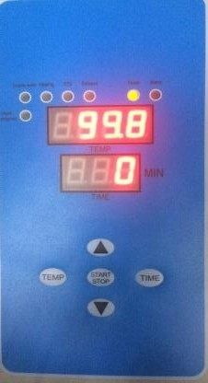
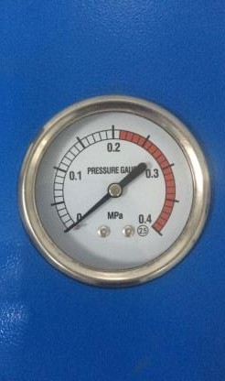
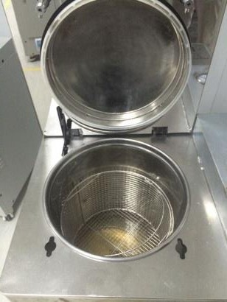
Sterilization temperature settings
Press“Time”button，the time display window displays time value and Flash. Adjust temperature value by “▲”、“▼”.Repress "Temperature" button, the temperature set is stored.
Sterilization and exhaust
After warming up, sterilization begins. Then exhaust begins.
When the equipment exhaust, put exhaust pipe
outside of drains. Don’t touch the exhaust pipe in case be burned.
End of sterilization
When sterilization is completed, the "Finish" light buzzer
beep every 10 seconds. "Finish" lights on, this sterilization ended.

Slide 18











Be sure that pressure gauge pointer back to 0. Then you can open the lid and get out items.
Preferences：
Press the "Start / Stop" and "temperature" button at the same time for 5 seconds to enter the menu
1) Showing“
”is water time in minutes, press the "Start / Stop" displayed value and
flashes，press “▲”、“▼”turn up or turn down, press "Start / Stop" to confirm. It must be 10
while showing“ ”，press“▼” showing“ ，press“▲” showing “ ”
Showing “ ”Indicates the end of the cool air discharge temperature, press the "Start /
Stop" displayed value and flashes，press “▲”、“▼”to turn up or turn down, press "Start / Stop" to confirm. The default setting is 100.0 ℃
Showing “ ”，press“▼”showing“ ”，press“▲”showing “ ”
Showing“ ”is exhaust cool air time in minutes, press the "Start / Stop" displayed value
and flashes，press “▲”、“▼”to turn up or turn down, press "Start / Stop" to confirm. The default setting is 30 minutes. (After the end of the exhaust cool air, temperature cannot be lower than the set temperature end value, otherwise it will alarm if the pot temperature exceeds 105 degrees will go to the next step directly)
while showing“ ” ，press“▼” showing“ ”，press“▲”showing “ ”
Showing“ ”is the time of drainage in seconds, press the "Start / Stop" and the value
display flashes, press “▲”、“▼”to turn up or turn down, press "Start / Stop" to confirm. Only solid program, the default is 240 seconds.
While showing“ ” ，press“▼”showing“ ”，press“▲”showing“ ”
Showing“ ”is sterilization pulsation frequency in seconds, press the "Start / Stop"
displayed value and flashes，press “▲”、“▼”to turn up or turn down, press "Start / Stop" to confirm. Only custom procedures for effective solid class, default 0.

Slide 19






While showing“
” ，press“▼”showing “
”，press“▲”showing“
”
Showing“ ”is drying time, in minutes, press the "Start / Stop" displayed value and flashes，press “▲”、“▼”to turn up or turn down, press "Start / Stop" to confirm. Only solid custom program, default 10.
While showing“ ” ，pressing“▼”showing“ ”，press“▲”showing “ ”
Showing“ ”is incubation temperature in degrees Celsius, press the "Start / Stop" displayed value and flashes, press “▲”、“▼”to turn up or turn down, press "Start / End" to confirm.
While showing“ ” ，pressing “▼”showing“ ”，press“▲”showing
“ ”
Showing“ ”is soaking time in minutes, press the "Start / Stop" displayed value and flashes，press “▲”、“▼”to turn up or turn down, press "Start / Stop" to confirm.
While showing“ ” ，press“▼”showing“ ”，press“▲”showing“ ”
Showing“ ”is the temperature correction factor, press the "Start / Stop" displayed value
and flashes，press “▲”、“▼”to turn up or turn down, press "start / stop" to confirm, modify user is strictly prohibited.
While showing“ ” ，press“▼”showing“ ”，press“▲”showing“ ”
Showing“ ”is the temperature deviation, press the "Start / Stop" and the value display flashes, pressing “▲”、“▼”to turn up or turn down, press "start / stop" to confirm, modify user is strictly prohibited.
While showing“ ” ，press“▼”showing“ ”，press“▲”showing“ ”，So the cycle.
After the modification is complete, press the "Start / Stop" and "temperature" button for 5 seconds to save the parameters and exit the menu.

Slide 20
Nnote:
If you want to terminate the process of sterilization , you can press "Start / Stop" button to end the sterilization process.

Slide 21
3.2.3 Fault indication
error code | cause of issue | Problems | solution
Err 001 | After 30 minutes, the pulsating exhaust air conditioner does not reach the set temperature | Heating broken, there are air leaks | Check or replace the heating pipe line leaks
Err 002 | Not reached within the time set by the cool air discharge temperature or pulsating exhaust failure | Heating bad parameter setting unreasonable | Replace the heating pipe or check whether the set parameters are correct
Err 004 | When the set temperature, the temperature is not stabilized within 10 minutes during the sterilization or excessive temperature fluctuations | There leak | Check the pot connector or line leaks phenomenon.
Err 008 | Sensor is not connected or damaged, the pot temperature below 10 ℃ | Sensor failure | Replace the sensor
Err 016 | PCB temperature component failure | Circuit board burned | Replace the circuit board
Err 032 | Within the set time no water add enough water | Bad water level float | Replace the water level float switch
Err 064 | Heating pot of water lead to dry | Missing or internal cavity temperature protection failure | Add enough water cooled enough, or replace the temperature protection
Corrective Maintenance
4.1 Maintenance
To ensure that the sterilizer in good working condition and minimize the number of failures, therefore, the operation described in this chapter must be followed.
1) Before starting maintenance, make sure the device is powered down. At the same time, no

Slide 22
pressure in sterilization container.
After the end of the working with a soft cloth or a piece of gauze to wipe the door gasket.
Remove the basket. With gauze with a detergent and water, wipe the inner wall of the sterilization container. Do not use steel slag wool or steel brush to avoid damaging the sterilization chamber wall.
Cleaning and sterilizing the container chamber to remove scale. The water in the tank let go.
Periodic inspection
Once a year, tightening fittings and detection-off state, should be completed by a professional electrician. Once, due to extreme wear and tear, lock device must be checked every five years.
Instructions: This repair manual is to provide professionals. Unless you are a professional, otherwise when the equipment fails, be sure to consult the instructions and press the manual for repair.
Instructions have been possible to provide professional maintenance methods.
Before starting maintenance, make sure the device is powered down.
At the same time, no pressure in sterilization container.
4.2 Failure analysis
Phenomena | Possible reasons | Correct Operation
Power switch is on, power | 1.The circuit breaker is | 1.Close the circuit breaker
light is not bright. | unclosed 2.The main power | 2.Change power switch in
 | switch is damaged | accordance of specific
 |  | conditions
Under the condition of | 1.Control circuit of the heater | 1.Check and change the
warming, Pressure and | shorts out or burns down | damaged elements 2.check,
temperature do not rise, or | 2.pipe joint or safety valve | tighten the pipe joint, safety
rise slowly | leaks seriously | valve, etc
4.3 Changing the sterilizer water
Remove the transparent silicone tube can drain until the water drain out.
Distilled water was injected into the sterilization chamber, the water level should reach the warning indicator light no longer show.
4.4 Checking the safety valve
It is located above the front left side of the device. In order to prevent the safety valve is in the blocked state, under normal use, , Allow the steam pressure release every two months.
According to the manual, operating sterilizer.
The pressure generated inside the sterilization container: 0.165MPa.

Slide 23
Use a screwdriver to push the safety valve handle, opening it about 2 seconds
Turn off the main switch, the operation is terminated. Meanwhile, exhausting the steam in sterilizer container.
Turn down the pressure is 0MPa before opening the door.
4.5 How to replace the safety valve
Instructions: The only professional repair methods can be used. Unless you are a professional talent, otherwise avoid electric shock, equipment malfunction, be sure to consult the instructions and press the manual for repair, while the specification has been possible to provide professional maintenance methods.
It is located above the front left side of the device.
Remove the valve mounting screws, remove the valve from the valve base. 3）With a qualified safety valve to replace it. Test the sterilization process.
4.6 Thermostat
Located inside the device. Sterilizer is equipped with a thermostat. In the heating and sterilization phases, it can be turned with the cut off the power supply to maintain a constant temperature.
Typically used as a temperature alarm device. If the pot temperature exceeds the allowable value, the thermostat automatically disconnect the heater power. When the pot temperature dropped below the allowable value, the thermostat automatically turns on.
4.7 How to improve the operating temperature of the thermostat
Thermostat is a liquid expansion thermostat, clockwise to increase the temperature range. (Note: The device is already regulate before delivered, customers do not need to adjust).
Service
To our distinguished guests:
Any product has the possibility of failure, please monitor the work of the equipment in real time during use, If any abnormal, please first refer to the manual for processing, If the problem still cannot
be solved, you shall inform our Customer Service Centre, to protect against loss. After-sales service
From the day when the equipment is sold (subject to the invoice), one-year free maintenance and all-life services.
The warranty card：When you need to normal consultation or maintenance, please contact to our after-sales service centers with the warranty card and the invoice, the warranty card must be well kept.

Slide 24
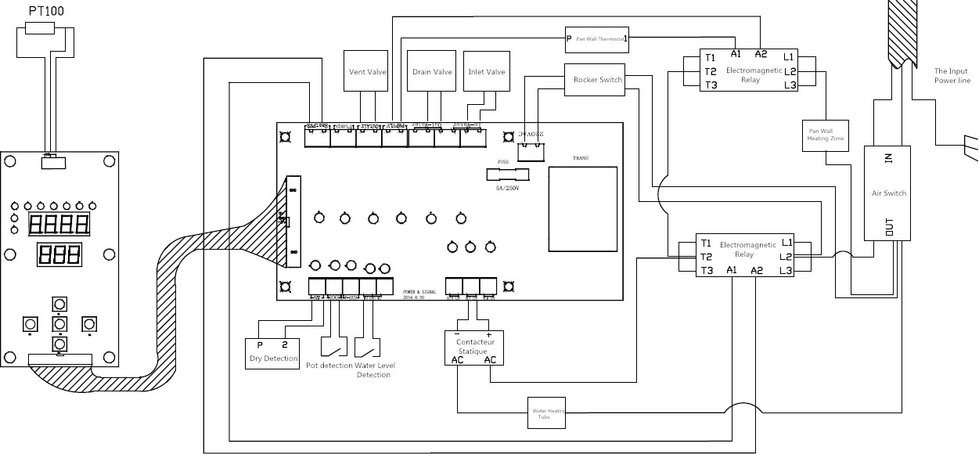
Appendix I electrical wiring diagram

Slide 25
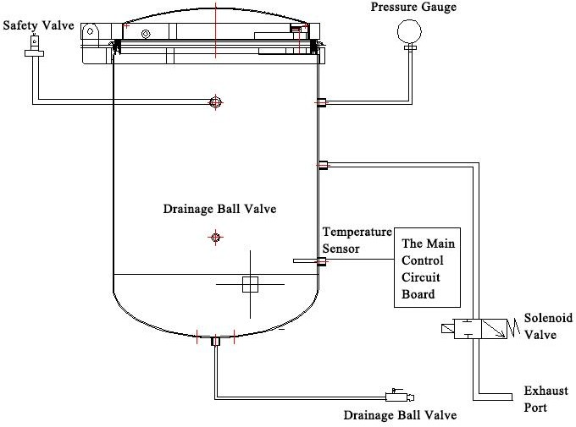
Appendix II PID piping schematics·

